Slide 1

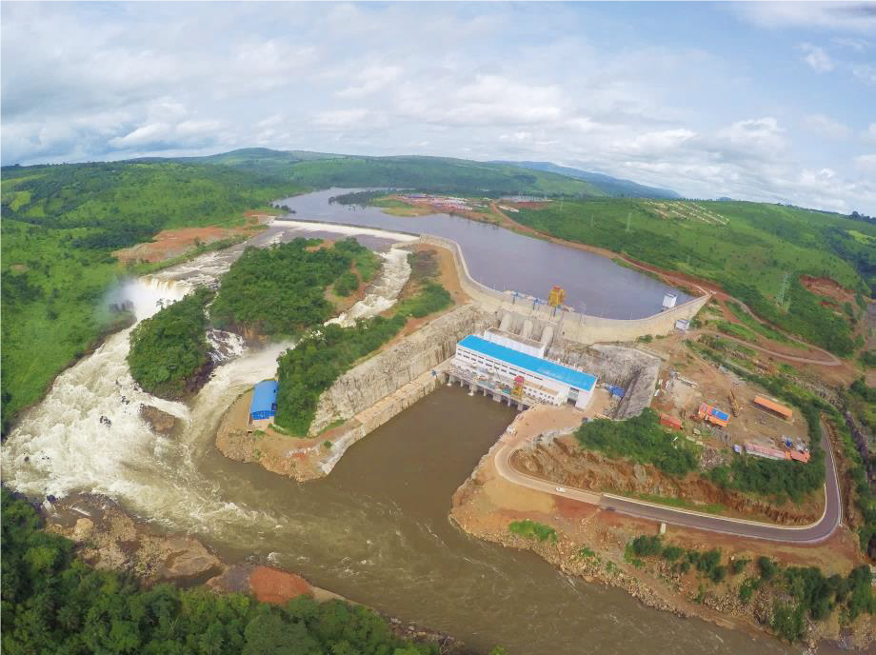
Invest in energy
Growing production for the rapid industrialization of the country

Slide 2
Plan
  General presentation
  Energy infrastructure
  Acquired
  Ongoing projects
  Investment opportunities

Slide 3
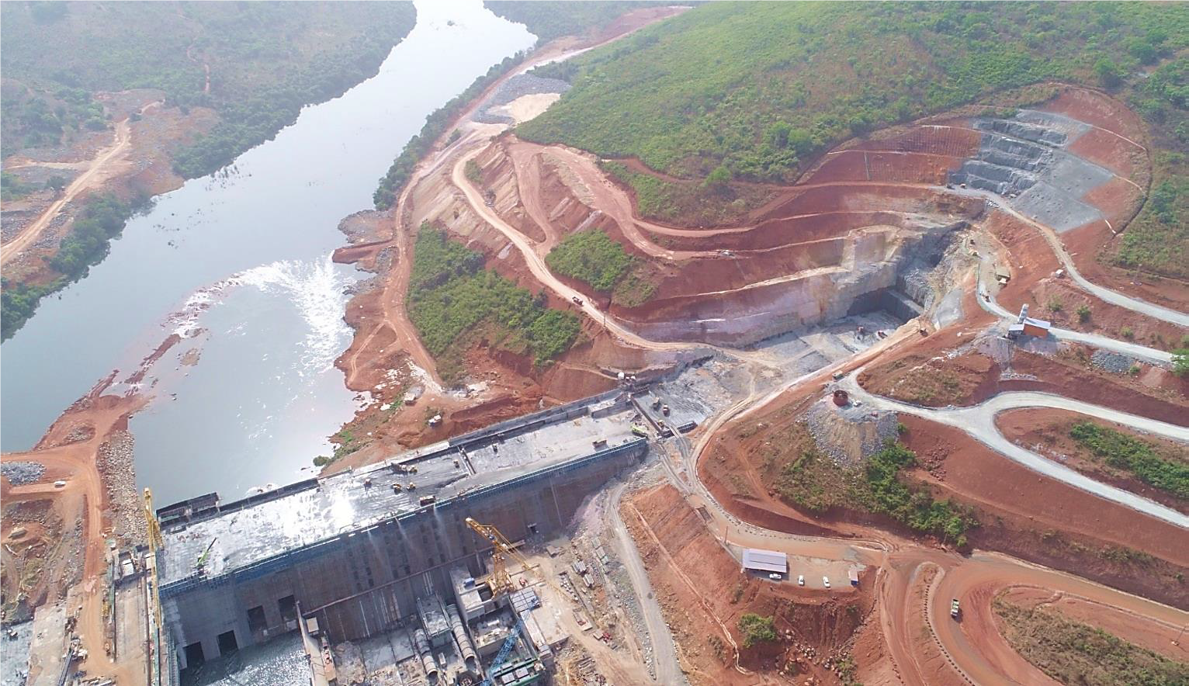
General presentation
3

Slide 4
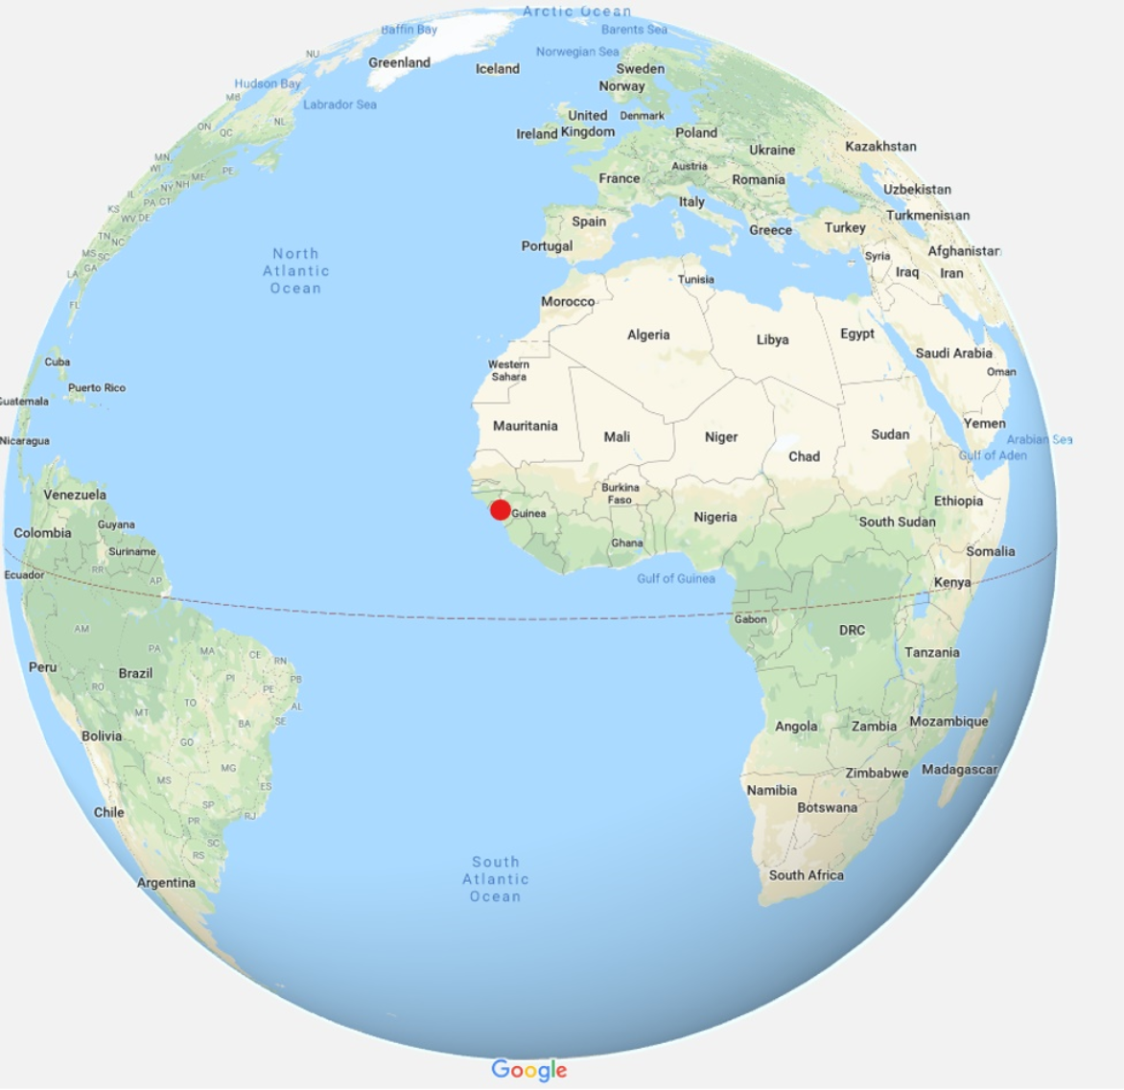
General presentation
Area: 245,857 Km²
Population: 12 million inhabitants
One of the highest growth rates in the world:
9.9% on average since 2016 (IMF)
Gain of 27 ranks in the World Bank's Doing Business in 7 years
Mobilization of more than 21 billion USD at
the PNDES Advisory Group for 2016-2020
Guinea-China framework agreement: 20 billion USD over 20 years for infrastructure financing

Slide 5
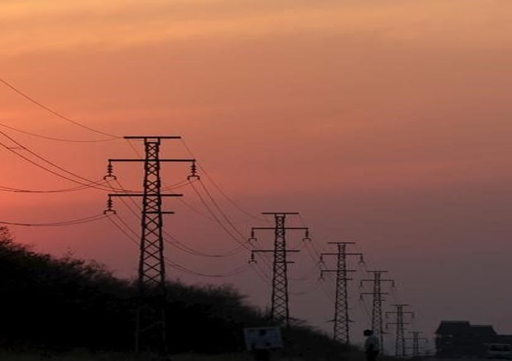
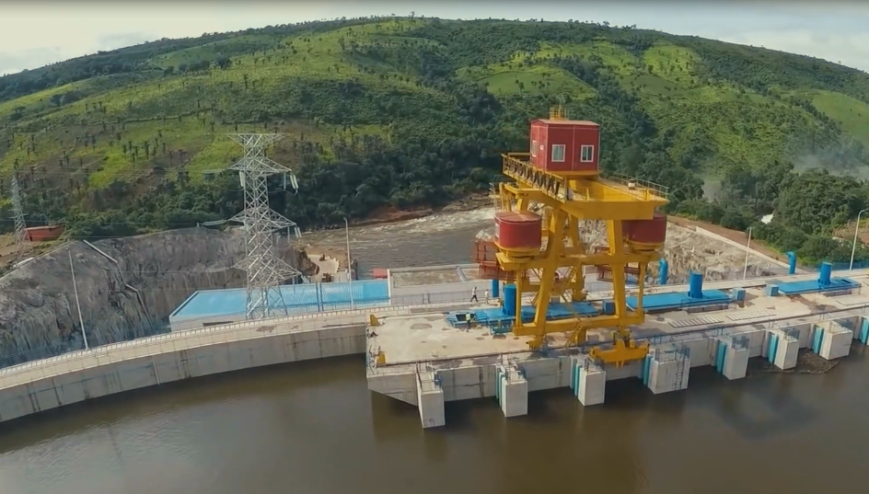
General presentation
Energy production potential of 9,300 GWH/year
1,165 watercourses
Hydroelectric potential estimated at 6,233 MW
Wind energy production potential with an average wind speed of 3m/s
Solar energy production potential with 4.8 Kwhm²/day of solar energy

Slide 6
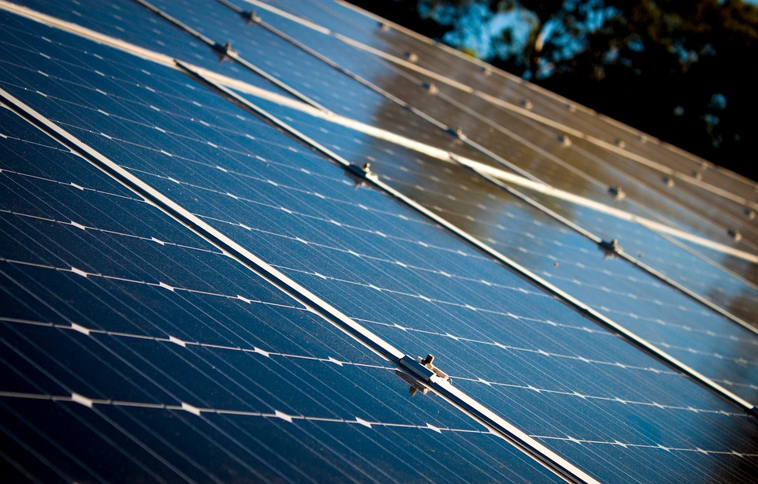
Energy infrastructure
6

Slide 7
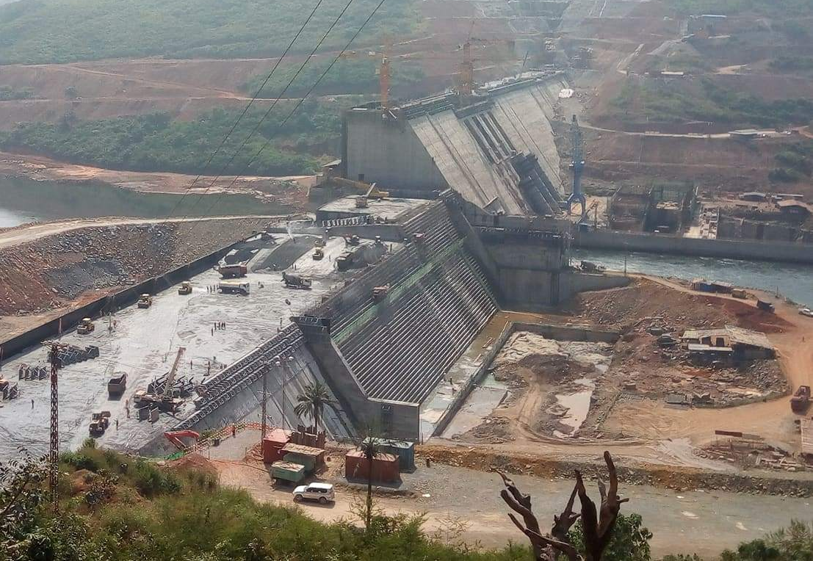
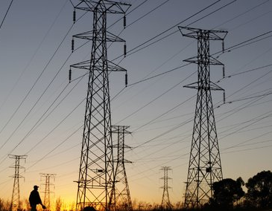
Infrastructures
Kaléta Dam
Energy service
Souapiti Dam
Opened in September 2015
240 MW production capacity
Doubling of Guinea's energy capacity at launch (from 212 MW to 450 MW,)
The interconnected network increased from 51.82% in 2014 to 86.46% in 2018
Souapiti is the third dam built on the Konkouré River
450 MW production capacity
Provides water retention for dams already in production with a water retention of 6 billion 375 million cubic meters
Construction of 8.2 km of medium-voltage lines (MV)
Construction of 23.6 km of low-voltage lines (LV)
Installation of 39 substations
26 prefectures and 36 localities were electrified from 2010 to 2018

Slide 8
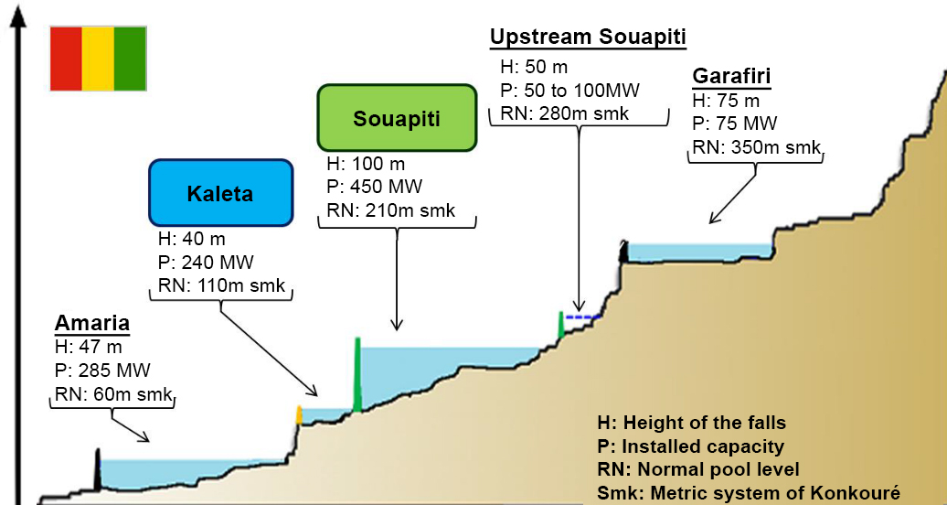

Slide 9
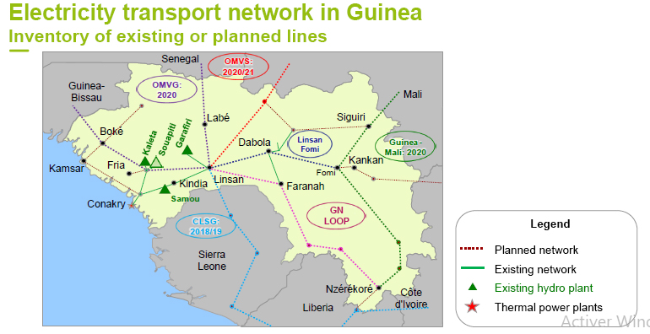
An improved service
Renovation of 1,230 km of networks
Reduction in the number of outages from more than 40 per month in 2015 to less than 1 at the end of 2016
80% reduction in load shedding hours

Slide 10
Acceleration of electrification and interconnection
Production
Distribution
Launch of construction work on the Amaria hydroelectric dam (300 MW)
Launch of the Koukoutamba hydroelectric development project (294 MW capacity)
Construction of a 90 MW hydroelectric dam on a Diani River site
Construction of a 90 MW hydroelectric dam on a Sankarani River site
Supply of mining areas (gold and iron):
  Linsan-Fomi 225kV line (planned for 2020)
  Linsan, Fomi, Kankan, Kérouané substations:
  Siguiri-Fomi-N’Zérékoré 225kV line
  (projected for 2020)
West African Power Pool : ECOWAS
Organization for the Development of the Gambia River: Gambia, Guinea, Guinea-Bissau, Senegal
The Senegal River Basin Development Organization: Guinea, Mali, Mauritania, Senegal
Niger Basin Authority: Benin, Burkina Faso, Cameroon, Côte d'Ivoire, Guinea, Mali, Niger, Nigeria, Chad
Signing in 2018 of a 130 million euro agreement with the European Investment Bank to connect more than 200,000 people in Guinea and to transport energy in Mali, Liberia and Sierra Leone

Slide 11
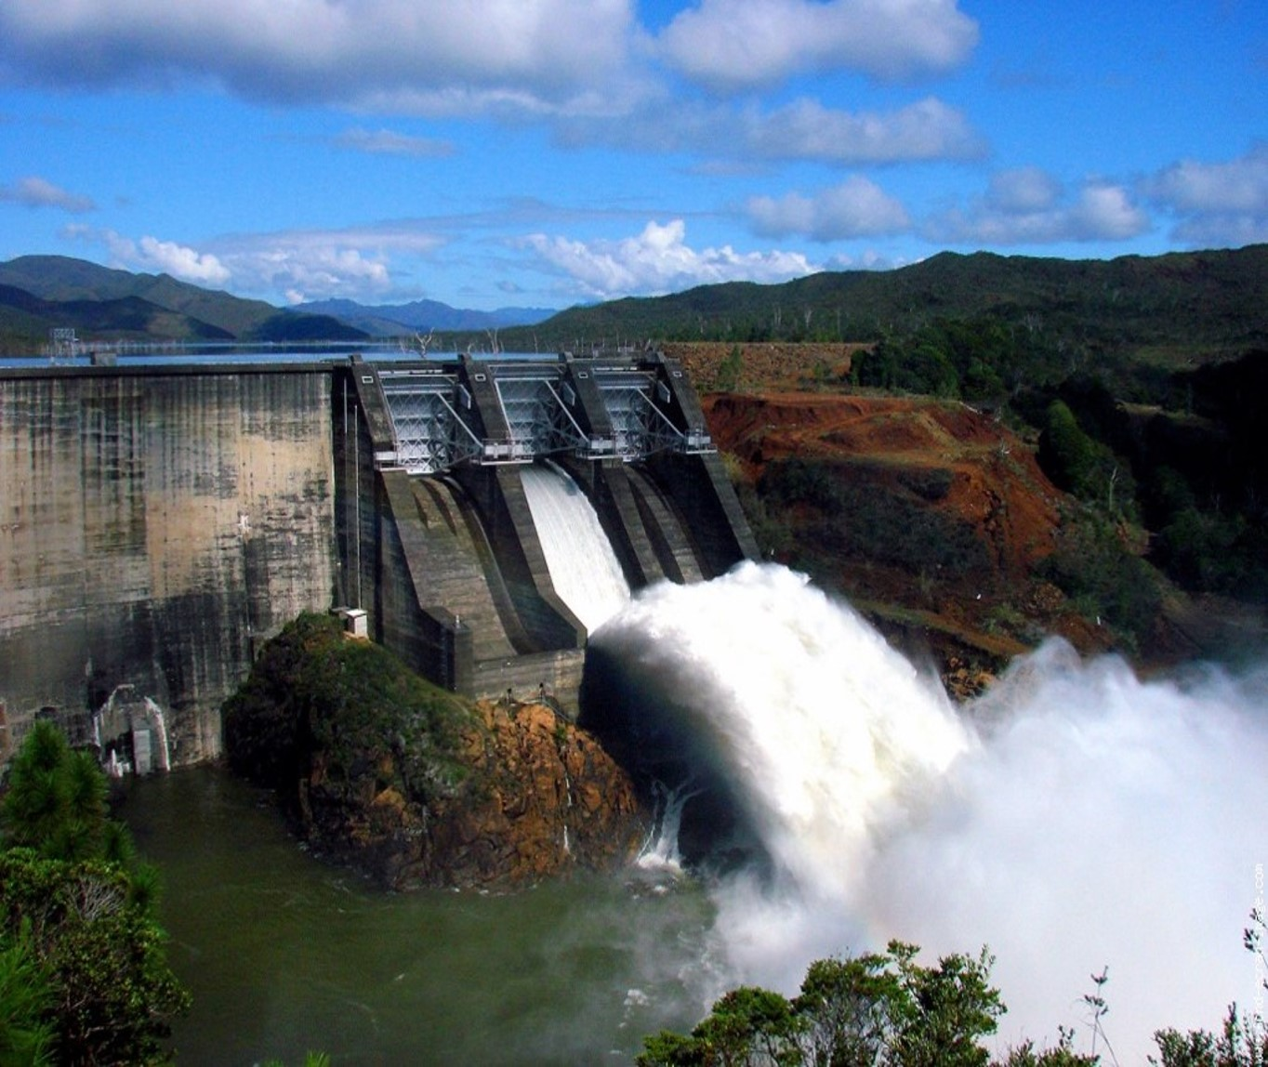
Investment opportunities
11

Slide 12
Investment opportunities
NO. | PROJECT | COST
1 | Rehabilitation of hydraulic power plants and source stations ("Guinea Energy Project") | 97.6 million USD (total project), of which 16.7 million USD remain to be financed (Donkéa Power Plant)
2 | National program to improve access to electricity in Guinea | 643.5 million USD
3 | Village Hydraulic Project in the prefectures of Kérouané and Mandiana | 16.5 million USD
4 | 4th Conakry Water Project Phase 1 | 250 million USD (1st phase)

Slide 13
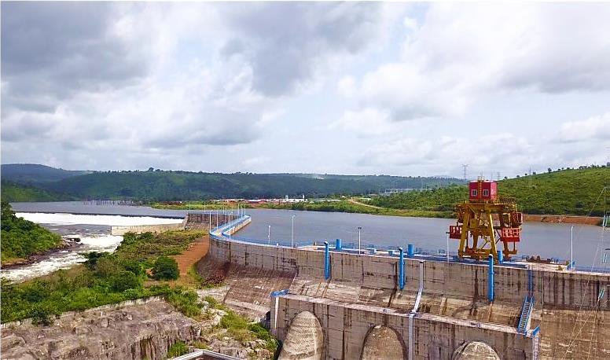
Thank you for your attention
Insert Image
www.invest.gov.gn

